Slide 1
Web API-Routing
Presented By:
Nithya Gopinath

Slide 2
Contents
Configure Web API
Convention-based Routing
Attribute Routing
Parameter Binding
Get Action Method with Primitive Parameter
Multiple Primitive Parameters
POST Action Method with Primitive Parameter
POST Method with Mixed Parameters
[FromUri] and [FromBody]

Slide 3
Configure Web API
Web API configuration process starts when the application starts.
Global.asax :
GlobalConfiguration.Configure(WebApiConfig.Register);
WebApiConfig.Register :
This function requires a parameter of type HttpConfiguration

Slide 4
Http Configuration
HttpConfiguration is the main class which includes following properties using which you can override the default behaviour of Web API.
Property | Description
DependencyResolver | Gets or sets the dependency resolver for dependency injection.
Filters | Gets or sets the filters.
Formatters | Gets or sets the media-type formatters.
IncludeErrorDetailPolicy | Gets or sets a value indicating whether error details should be included in error messages.
MessageHandlers | Gets or sets the message handlers.
ParameterBindingRules | Gets the collection of rules for how parameters should be bound.
Properties | Gets the properties associated with this Web API instance.
Routes | Gets the collection of routes configured for the Web API.
Services | Gets the Web API services.

Slide 5
Web API Routing
It routes an incoming HTTP request to a particular action method on a Web API controller.
Web API supports two types of routing:
Convention-based Routing
Attribute Routing

Slide 6
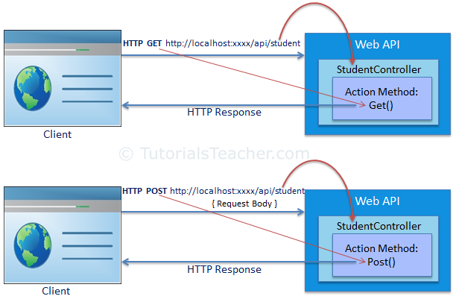
Web API Routing Illustration

Slide 7
1. Convention-based Routing
Web API uses route templates to determine which controller and action method to execute.
At least one route template must be added into route table in order to handle various HTTP requests.

Slide 8
2. Attribute Routing
Attribute routing is supported in Web API 2.
In order to use attribute routing with Web API, it must be enabled in WebApiConfig by calling
config.MapHttpAttributeRoutes();
Route Attribute can be used.

Slide 9
Parameter Binding
Action methods in Web API controller can have one or more parameters of different types.
It can be either
primitive type(int, bool, double, string, GUID, DateTime, decimal or any other type that can be converted from string type) or
complex type (composition of more than one primitive type)
Web API binds action method parameters either with URL's query string or with request body depending on the parameter type.
For primitive type- it sets the value of a parameter from the query string.
For complex type- it tries to get the value from request body by default.

Slide 10
Default Rules for Parameter Binding
HTTP Method | Query String | Request Body
GET | Primitive Type, Complex Type | NA
POST | Primitive Type | Complex Type
PUT | Primitive Type | Complex Type
DELETE | Primitive Type, Complex Type | NA

Slide 11
Parameter Binding
Query string parameter name and action method parameter name must be the same (case-insensitive).
If names do not match then values of the parameters will not be set.
The order of the parameters can be different.

Slide 12
Get Action Method with Primitive Parameter
Pass primitive parameter as query string.
Eg: http://localhost/api/myschool/student/?id=1

Slide 13
Multiple Primitive Parameters
Web API will try to extract the values from the query string of request URL.
Eg: http://localhost/api/myschool/student?id=6&name=student1

Slide 14
POST Action Method with Primitive Parameter
HTTP POST request is used to create new resource.
It can include request data into HTTP request body and also in query string.

Slide 15
POST Method with Mixed Parameters
Post action method can include primitive and complex type parameters.
Web API will get the id parameter from query string and student parameter from the request body.

Slide 16
[FromUri] and [FromBody]
Use [FromUri] attribute to force Web API to get the value of complex type from the query string
Use [FromBody] attribute to get the value of primitive type from the request body, opposite to the default rules.

Slide 17
THANK YOU

